Slide 1
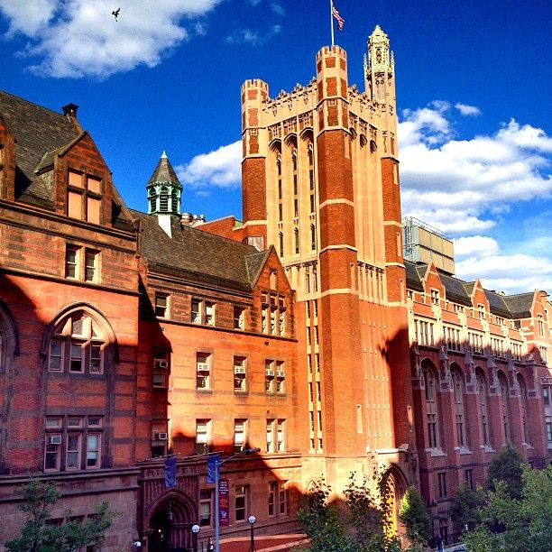
Select Findings from the Fall 2018 Enrolled Student Survey

Slide 2
The Enrolled Student Survey
This survey collects general feedback about student satisfaction and experiences to understand how TC students think and feel about their experiences at the college.
The survey is administered twice a year, once during the Fall and once during the Spring. It includes a series of core questions and semester-specific additions.
The Fall 2018 survey addressed a range of topics, including satisfaction with on-campus housing and new student orientation.
There were 1,381 responses to the survey, resulting in a nearly 30% response rate.

Slide 3
How representative were the survey respondents of the total enrolled population?
Overall, survey respondents were representative of the total enrolled population by department, gender and degree.

Slide 4
Student Satisfaction
Respondents expressed a high degree of satisfaction. Upward of 70% indicated that they were “satisfied” or “very satisfied” overall, as well as specifically with the quality of teaching and the availability of their advisor.
Notes:
Q6.7

Slide 5
Student Perceptions of TC
Nearly 90% of respondents rated the overall reputation of TC positively (“good” or “excellent”).
The majority of respondents rated the quality of academic advising (65%) and variety of course offerings (72%) positively.
Notes:
Q6.6

Slide 6
Student Perceptions of TC
Nearly 75% of respondents rated their program as one of the best in the field.
Approximately 82% of survey respondents agreed that their courses have practical implications.
Notes:
Q6.10

Slide 7
TC Offices & Resources
When asked about their interactions with offices and resources across the college, respondents were generally satisfied, with only a small minority indicating dissatisfaction.
Satisfaction with the TC library was notably high.
Notes:
Q6.8

Slide 8
Employment Status
Employment by degree level
Degree level | Not Working | Working | Total
Doctoral | 77 (25.8%) | 221 (74.2%) | 298
Master’s | 531 (50.0%) | 531 (50.0%) | 1062
Total | 608 | 752 | 1360
Approximately 55% of all respondents indicated that they were employed.
Nearly three-quarters of Doctoral respondents indicated that they were employed, compared to half of responding Master’s students.
52% of employed students report working 30 or more hours per week.
Notes:
Q6.1, 2

Slide 9
New Student Orientation
Newly admitted students were asked if they felt TC’s orientation process adequately prepared them for the first few weeks of classes.
Approximately 85% of newly-admitted respondents indicated that they attended new student orientation (n=623).
Of those who attended, 81% felt that orientation adequately prepared them for the first few weeks at TC.
n=524
Notes:
Q5.1 , Q5.3,

Slide 10
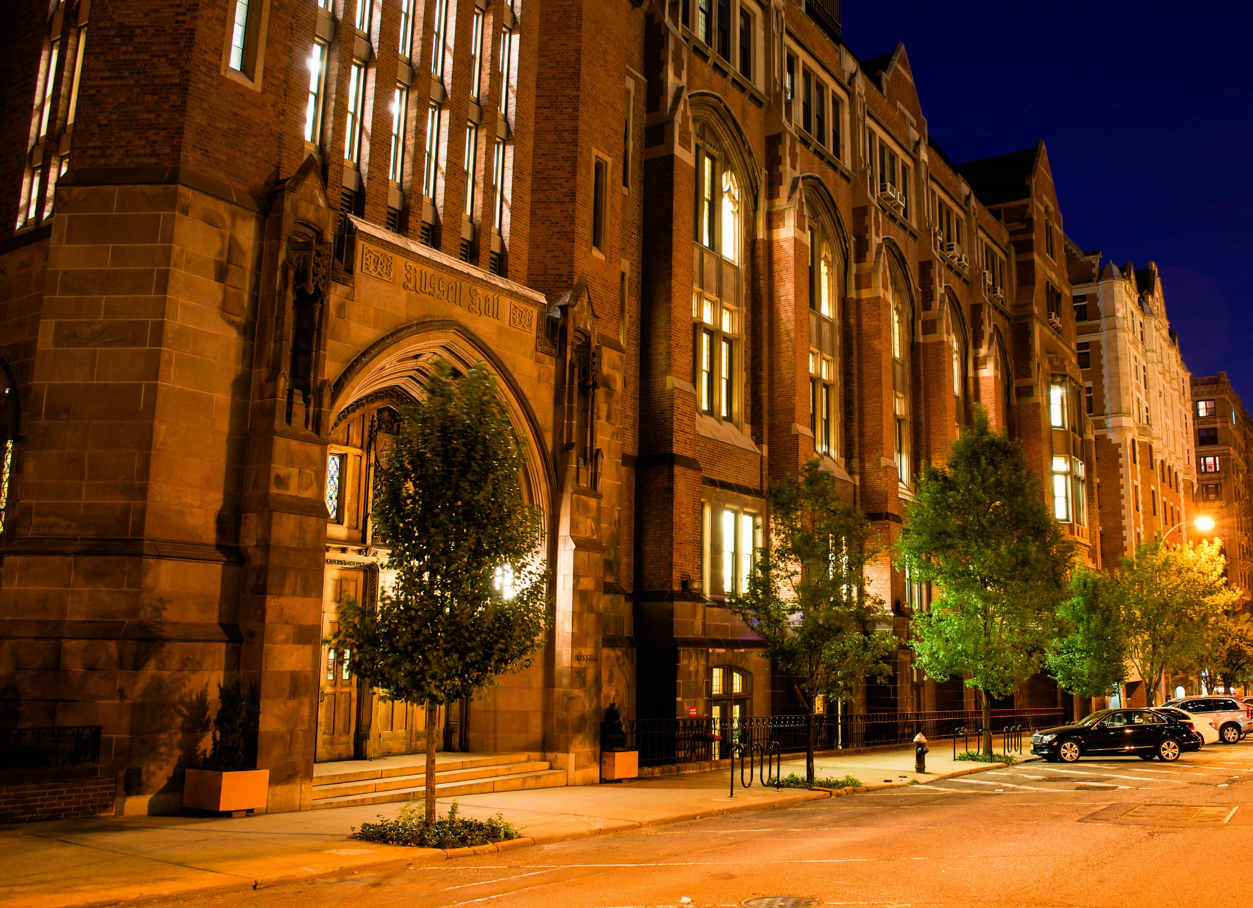
Questions or comments?
Please contact the Office of
Institutional Research
134 Thompson Hall institutionalresearch@tc.columbia.edu

