Slide 1
MASTER’S STUDENTS
FACULTY
DEGREE AUDIT GUIDE

Slide 2
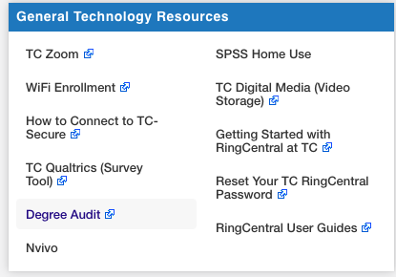
How to Access Degree Audit
Sign into MyTC
Locate the Degree Audit link on the top left hand side of the Employee Resources page
Click on the link. NOTE: The link will automatically direct you to the Degree Audit system

Slide 3
Home Page (overview layout)
Tabs-Home: Default Page-Current Audit: Displays the student’s audit
Search Bar: Search for students by using First, Last name and/or TC ID
o Student Focus: Will display all students or only students that have been assigned to you (as the advisor)
Notifications: Will display alerts for any action taken on the audit that needs to be reviewed
Communicator is the tool in which an advisor is able to store academic notes relating to the student’s academic progress. It is used as an advisory tool, much like the note action when making an exception. NOTE: Depending on the role in advisor will depend whether or not the user has access to the communicator tool.

Slide 4
Creating an Audit
Using the drop-down menu will display the Student Focus and the Search Bar
Enter the student’s information (name or TC ID) and click search or find the student under your “focused” list
Click on the student name to bring up the student’s academic goals page.

Slide 5
Creating an Audit
Audit History: Displays previously run audits along with the name of the person who ran it
Create Audit: Runs an audit on the currently highlighted Academic Goal

Slide 6
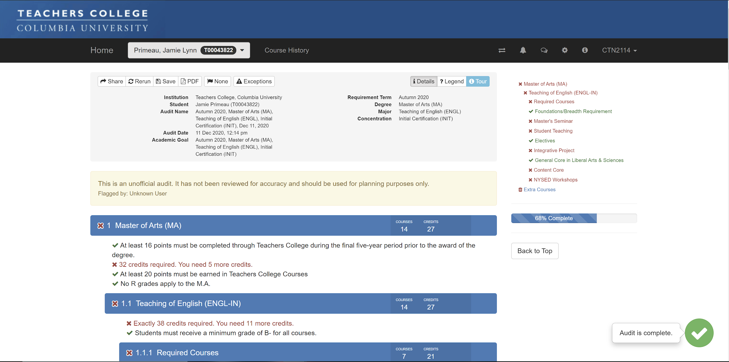
Note: The first time a user runs an audit, a tour will highlight the features of the degree audit

Slide 7
Current Audit Overview
Actions
General Degree Information
Audit
Note: Most used action will be Exceptions. Once an exception is made, you may click Rerun to see how it is applied.

Slide 8
Current Audit Overview: Audit Actions
Click on a requirement. The exceptions tab for that requirement will pop up.
Move Course: only allows courses to be moved to requirements they can legitimately satisfy. If a course does not meet all the parameters of a particular requirement, it cannot be moved under that specific requirement.
Exception: allows the user to force satisfy requirements and map courses to any specific requirement area. Making exceptions disregards parameters that have been set by the requirement. Managing exceptions allows the user to edit/delete exceptions

Slide 9
How to Move Courses
Click on the Move Courses Tab to reveal the Move courses panel.
Click the down arrow to reveal course options. You may also see a list of compatible courses below the dropdown menu.
NOTE: Courses that can be moved will appear in a drop down list. If a course does not appear in the list, it cannot be moved to satisfy that requirement.

Slide 10
How to Move Courses (cont)
Click on the course you would like to move to the requirement. This will collapse the dropdown menu and only display the selected course. Click on Move Course to complete the move. This will rerun the audit to reflect your move.
To cancel a move, just click on the x in the top right next to the tour button.
Your moved course will look as follows with an anchor. To lock it in place, click the anchor and it will turn into a pin. This will allow your advisor and the Registrar to be able to see the moved course.

Slide 11
Creating Exceptions
Clicking on the down arrow under the Exception tab will typically reveal 3 options:
Force Map: This exception forces a specific course to be mapped to the target course list. (used to map courses)
Force Satisfy: This exception forces a specific requirement or parameter to be considered satisfied, even when this would not normally be the case. (used to satisfy projects, comprehensive exams, etc.)
Note: This exception creates a note for all users to see. Purely used as an advisory tool.

Slide 12
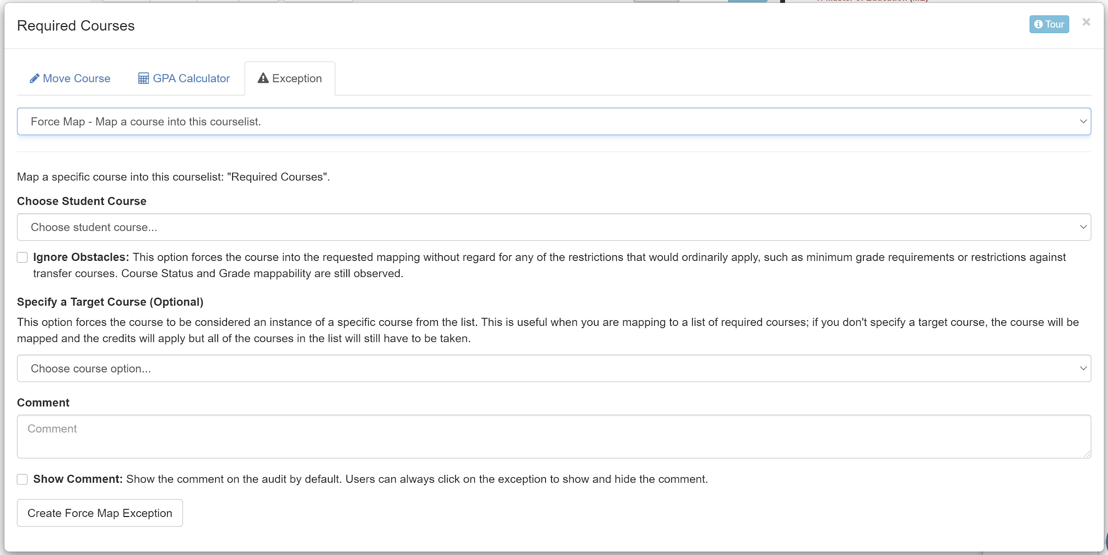
Creating Exceptions (Force Map)
Click Ignore Obstacles only when you are only force mapping a course to the requirement and not using the course as a substitute for a required course in that section.
Use the Specify a Target Course when substituting the Forced course with a course that is normally required for this section. (e.g., Course A is equivalent to Course B)

Slide 13
Creating Exceptions (Force Map cont)
In the comment section, include the reason for the exception. For example: C&T 1234 replaced course requirement HUDM 1234
or Advisor approved 12/13/12.
Click Create Force Map Exemption.
The exception will be listed and by whoever made it. Comments will be listed on the right. If you clicked the Show Comment button, it cannot be hidden on the audit..

Slide 14
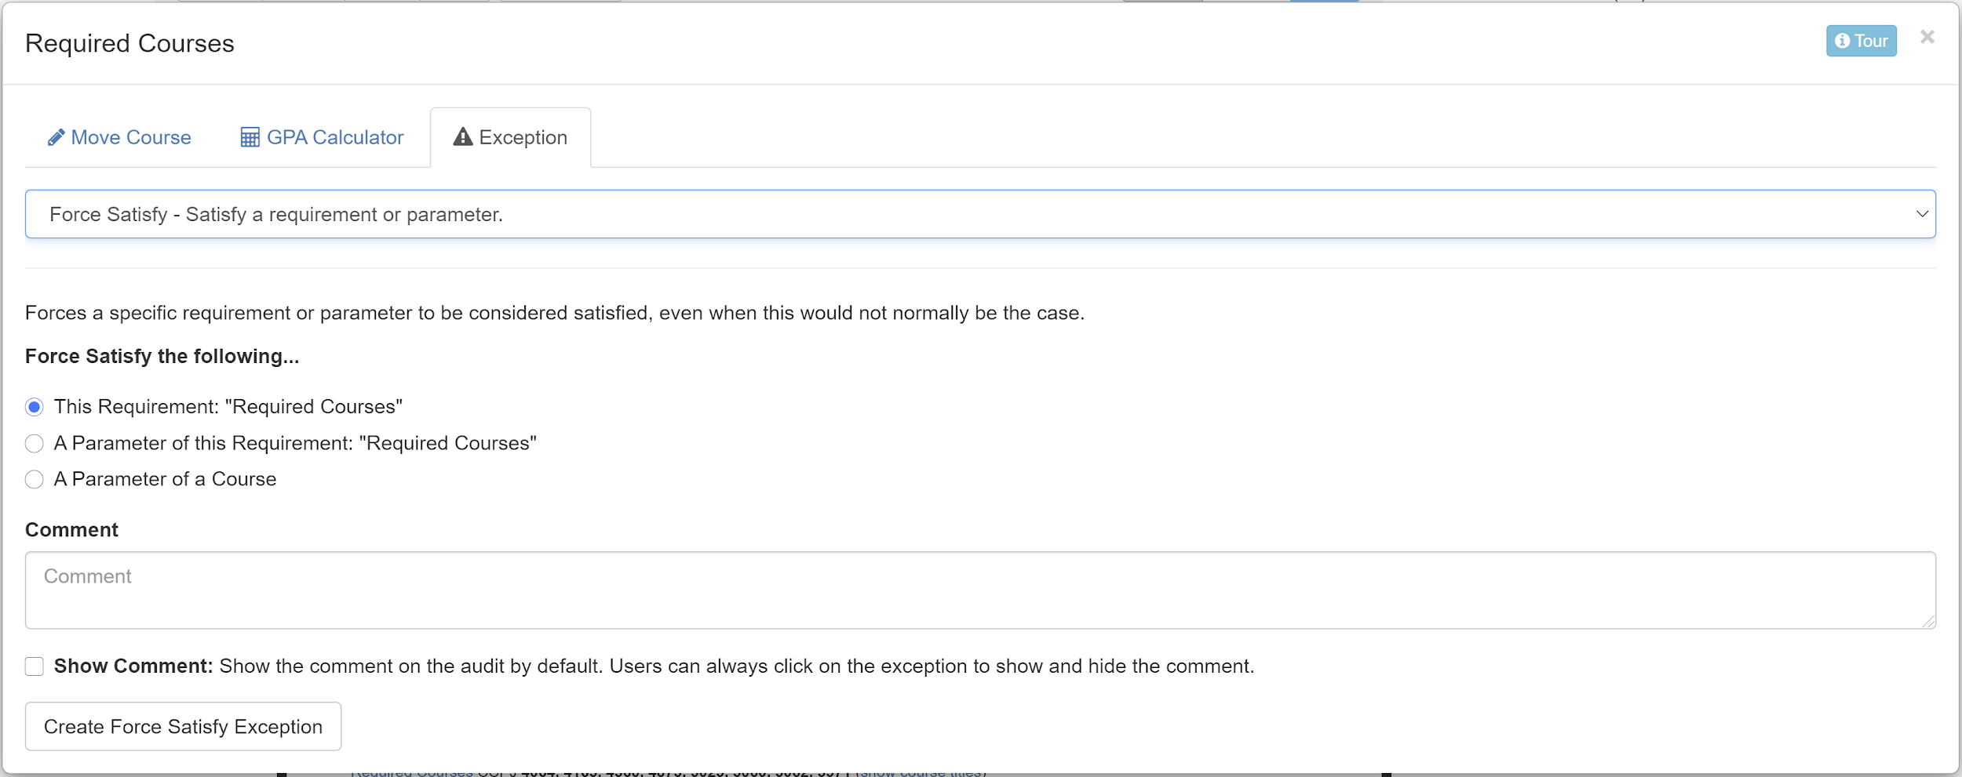
Creating Exceptions (Force Satisfy)
Force Satisfy: This exception forces a specific requirement or parameter to be considered satisfied, even when it would not normally be the case. (e.g., approving a section that still requires one course to complete)
This action also satisfies a requirement without a course. (e.g., projects, comprehensive exams, etc.)

Slide 15
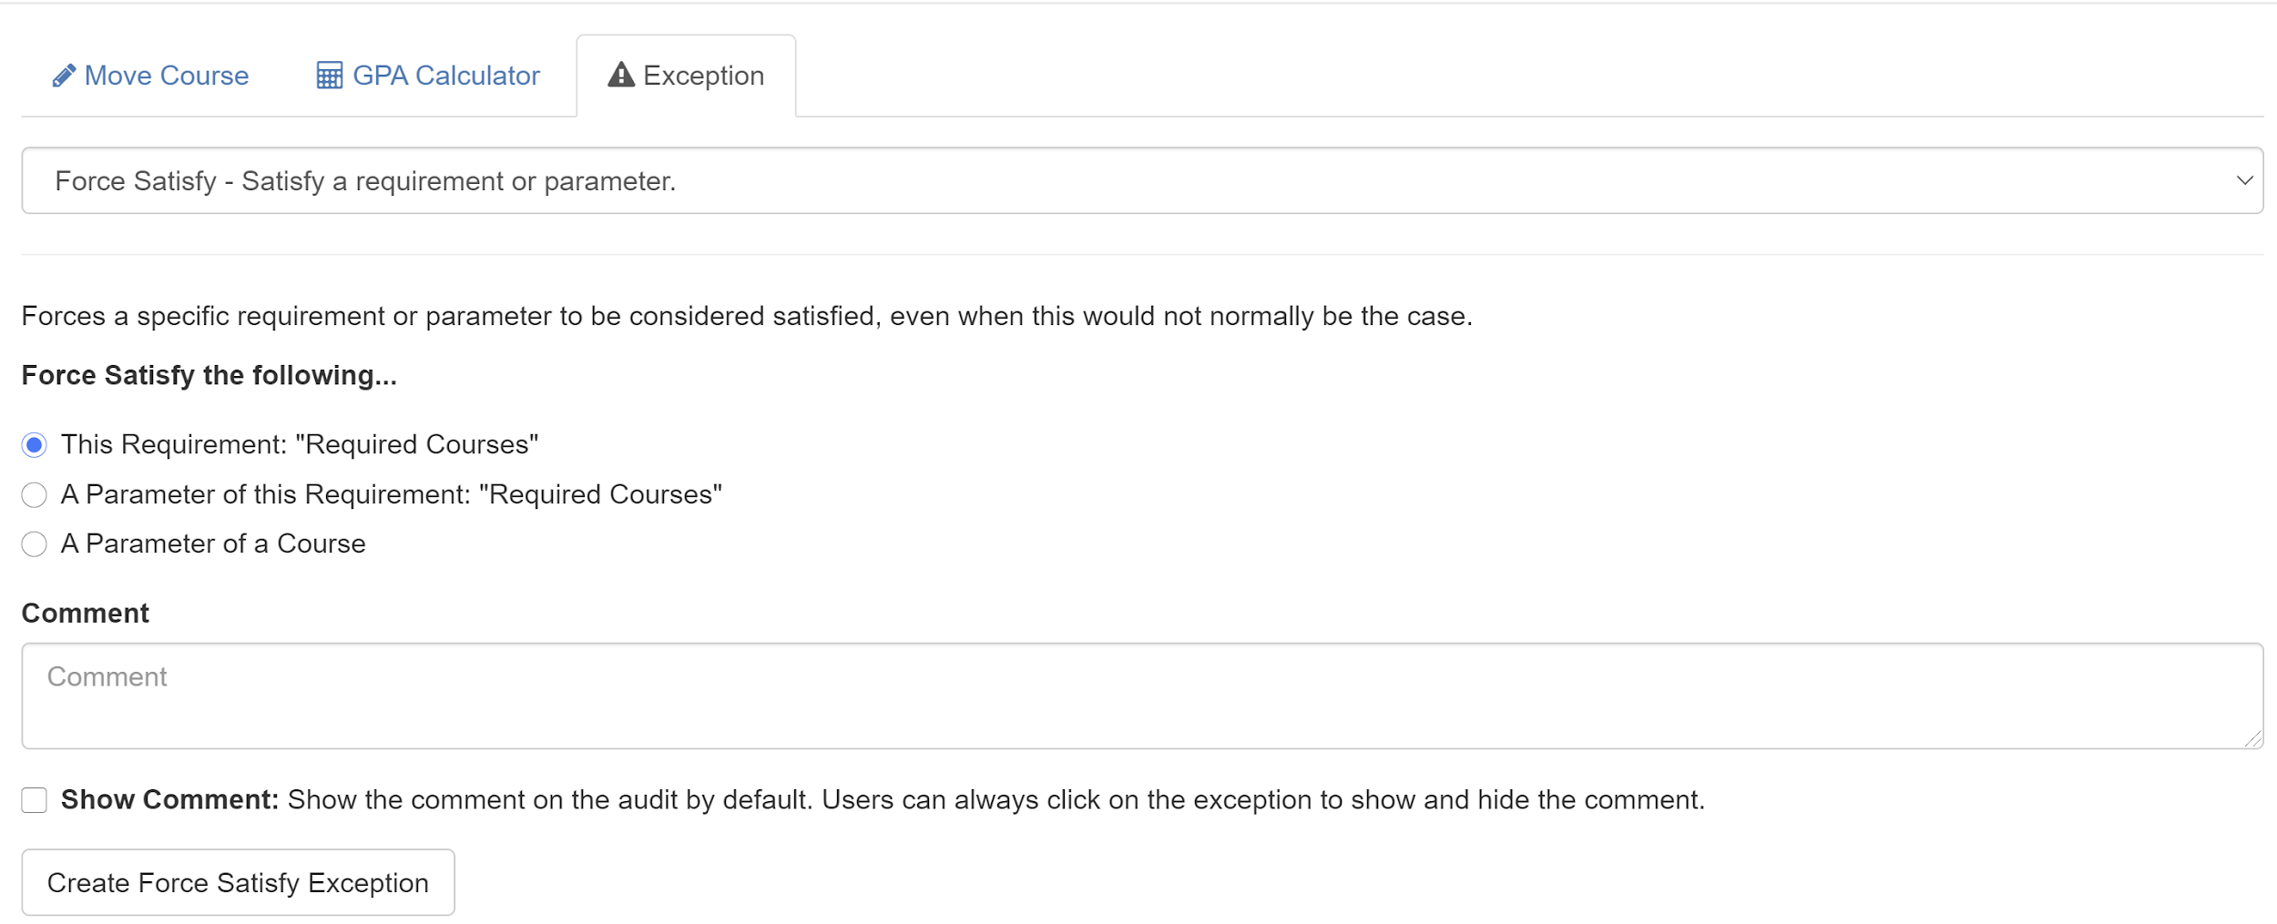
Creating Exceptions (Force Satisfy cont)
Select the first option: “This Requirement: “<Requirement name>”
Fill in the Comment section with the date the requirement was completed. If you are not the academic advisor, you must also include whom you are approving this for.
Select Create Force Satisfy Exception to create the exception. This will rerun the audit to reflect the exception.
NOTE: For projects, exams, and other similar requirements, the date or month and year must be included in which the requirement was completed. Semester and year (Fall 2011) will not be accepted. (i.e. Completed Project 6/13/09 or June 2011)

Slide 16
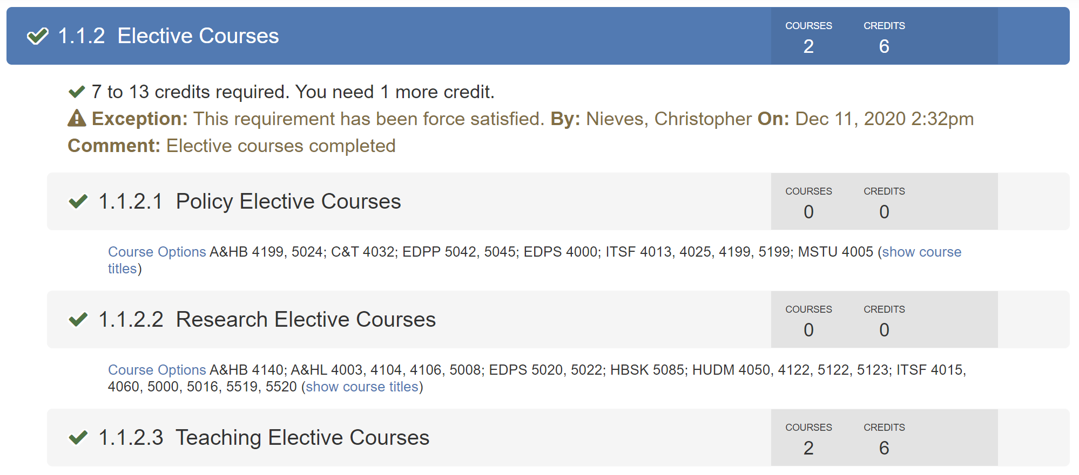
Creating Exceptions (Force Satisfy cont)
Force Satisfy can satisfy a section (1.1.2 Elective Courses in this example) and will also satisfy any subsection under it (subsections 1.1.2.1 through subsection 1.1.2.3 in this example)
NOTE: This will display Exception information in the same way that Force Map does.

Slide 17
Creating Exceptions (Note)
Type your note in the Comment section. Click on Note - Show a message on the audit to create your note.
NOTE: Adding a note does not force satisfy or map a course to a requirement. The action adds a note to the requirement. For example: “Student has met this requirement thru TC, post-baccalaureate and undergrad coursework.” The image below demonstrates how the comment will appear on the student’s audit.

Slide 18
How to Manage Exceptions
Click on the Exceptions button to reveal all exceptions for the student
Click on an exception to highlight its options

Slide 19
How to Manage Exceptions (cont)
You will be able to edit the comment by typing in the comment section and click save.
Your other option will be to delete an exception.
If you click Delete it will ask you to confirm:
Click Yes to confirm deletion. This will rerun the audit.

Slide 20
Save/Rename
Click Save to open up the save/rename dialog box

Slide 21
Save/Rename
Type the name if you’d like to name the audit (i.e. May 2018 Graduation) and click save to save your audit
Rename the audit (optional) and save the audit. Saved audits will be stored and appear in the Audit History section on the previous page (Home tab).
NOTE: Saving an audit will save the data/information for the present audit only. Always create a new audit in order to view the most current degree audit.

Slide 22
PDF View and Audit Flag
Clicking on the PDF option will immediately create a pdf file of the audit and download it directly to your computer.
The Audit Flag button is NOT used for Master’s students. This will only be used by advisors of Doctoral Students for their Program Plan of Study.

Slide 23
Communicator
Communicator is the tool in which an advisor is able to store academic notes relating to the student’s academic progress. It is used as an advisory tool, much like the note action when making an exception.
NOTE: Depending on the role in advisor will depend whether or not the user has access to the communicator tool.

Slide 24
Communicator (cont.)
Click on the communicator tab and then select student to get to the desire student communicator window
Use the Student Focus drop down menu or Search by the student’s name or TC ID (T12345678) to select a student.

Slide 25
Communicator (cont.)
A dialog box will open up for that student with a message box. For example: Advised to take C&T 1234 in place of HUDM 1234.
Select the submit button to commit the record.

Slide 26
Communicator (cont.)
Here you will see each message that is viewable to or viewable by you

Slide 27
Communicator (cont.)
You can choose who can view your message by clicking Choose Recipients prior to submitting a message or after the fact by
using the arrow next to a message created by you

Slide 28
Have questions or Concerns?
If you have any questions or concerns regarding the degree audit system, contact us via email at ctn2114@tc.columbia.edu.
Office Location:
(Due to COVID-19 pandemic, the Office of the Registrar is working remotely)
Phone:
212-678-4056
Office Hours: Monday-Friday 9 a.m. – 5 p.m.

