Slide 1
Guidebook: Registering for Courses
On Your myTC Portal
Office of the Registrar

Slide 2
An Overview and Table of Contents
This guide will provide you with general steps on navigating the myTC portal so you can register for courses. Before registering for courses, we recommend always checking in with your program advisor to know which courses to register for every semester.
This guide will review the following:
  1. Searching for courses on the myTC portal
  2. Registering for courses
  3. Adding/Dropping/Withdrawing Courses
  4. Changing Number of Credits

Slide 3
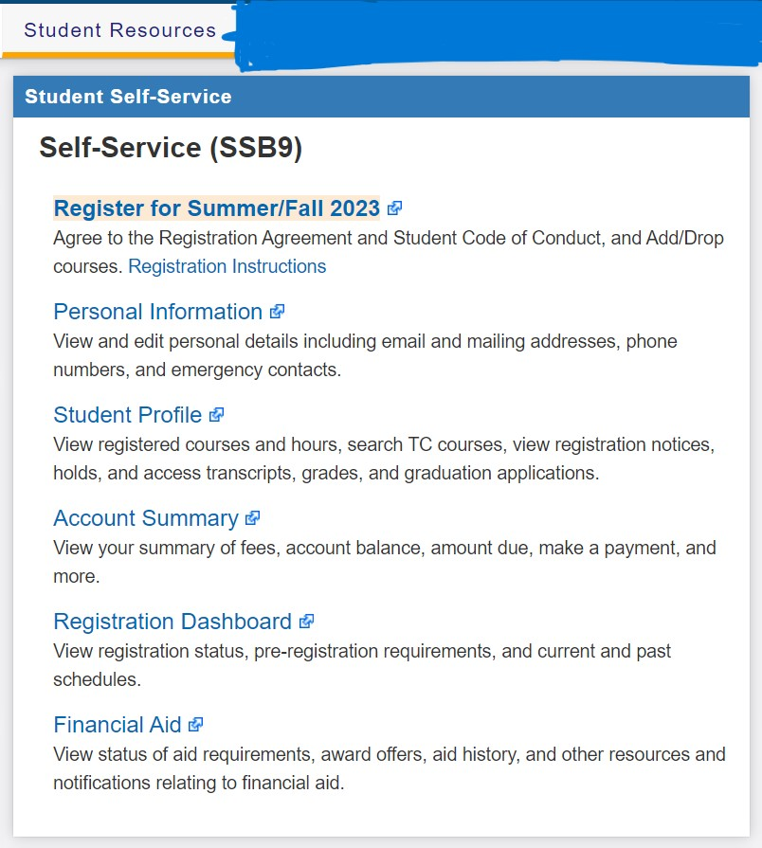
Navigating the myTC Portal
You can access the portal using this link: http://my.tc.columbia.edu
Under “Student Resources” you will find the Student Self-Service section of your portal where you can access any registration related information
Take your time to read through each function for each link. A description is provided on the screenshot.

Slide 4
Searching for courses on the myTC portal
To search for courses, you will click on “Register for Summer/Fall 2023”
Enter the term you want to register for
You can search for classes multiple ways:
  Find classes: You can enter the subject and course number and click search. You can also click on “Advanced Search” to filter out courses by time, dates offered and more.
  Enter CRN’s: A CRN is a unique pin assigned to each course offered in a semester. You can find the CRN through the course catalog
    **If you enter CRN. You can just click “Add to Summary” and it will get added to your cart so you can register for the course

Slide 5
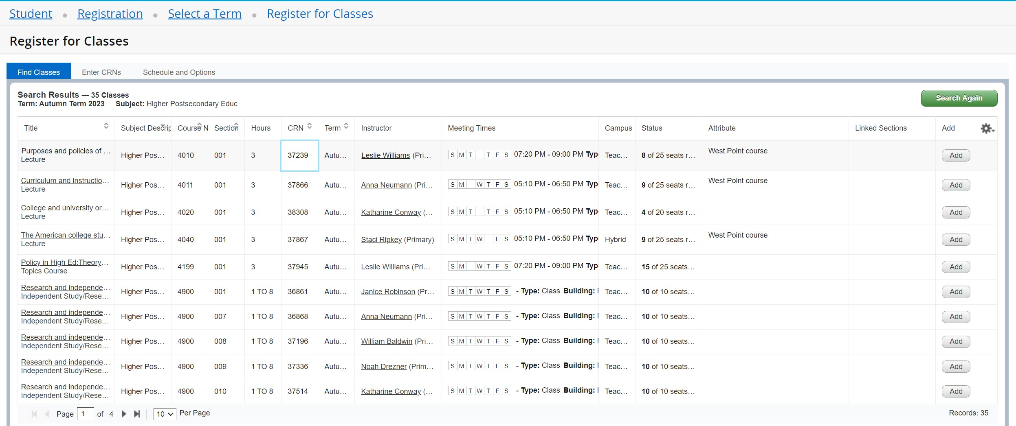

Searching for Courses Cont.
Once you enter all information about the course you want to add, click “Search” and all courses with that criteria will populate.
Click “Add” on the right hand to register for the course

Slide 6
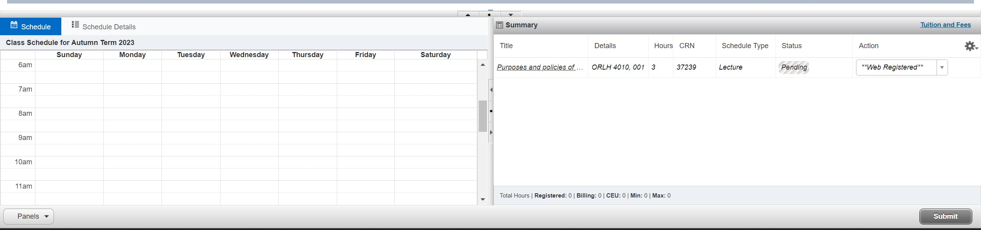

Registering for courses
Once you click “Add”, the summary and schedule will pop up at the bottom of your screen.
Click “Submit” to officially register

Slide 7

Dropping/Withdrawing Courses
What is the difference between dropping and withdrawing from a course?
  There is a deadline every semester to add and drop courses listed on the academic calendar. You can “drop” a course until the deadline. After the deadline, you will have to “withdraw” from a course.
  To drop or withdraw from a course, go to your summary and under “Action” a dropdown menu will appear where you can make the change

Slide 8
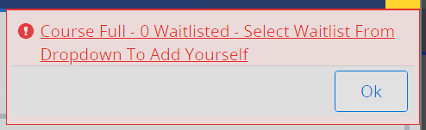
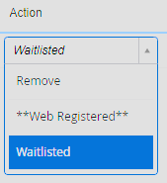

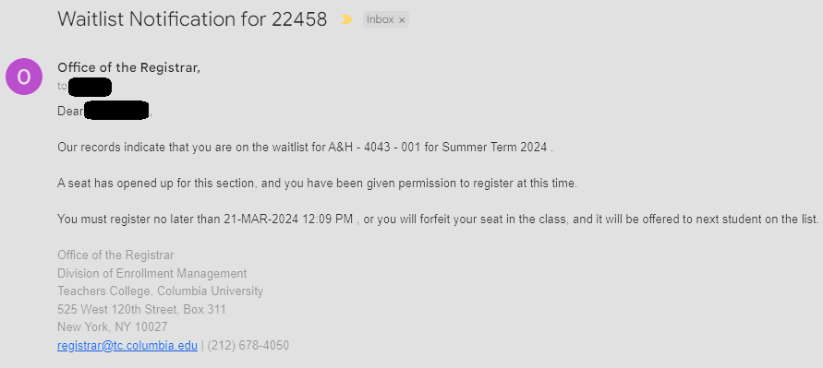
Waitlisting Courses
What happens when the course you are trying to register for is full and has a waitlist?
  Some sections have a waitlist. When attempting to register for a course that is full and waitlist eligible, you will get the following prompt informing how many students are in a waitlist.
  To waitlist for a course, go to your summary and under “Action” a dropdown menu will appear where you can select “Waitlisted” to update your status
  When a seat opens for you, you will receive an email informing you the course is open. You will have a 24-hour deadline to register yourself before you forfeit the seat.

Slide 9
Changing Number of Credits
For some courses, you can choose the number of credits you would like to take it for. Please consult with your advisor about this.
By going back to the beginning of the registration screen, you can click “Schedule and Options” to update the number of credits you would like to take a class for.
Always make sure to click “Submit” to save any changes

Slide 10
Quick Tips for Registration
Always consult with your advisor or program for any support on making academic decisions regarding your schedule
If you have any holds, you will be notified when you try to register for courses. For support on removing the holds please reach out to registrar@tc.Columbia.edu or call us at (212)678-4050
For any deadlines, please visit the academic calendar here: https://www.tc.columbia.edu/academics/academic-calendar/2023-2024/
To see the progress, you have made every semester, access your degree audit through your myTC portal

Slide 11
Thank you!

